Slide 1
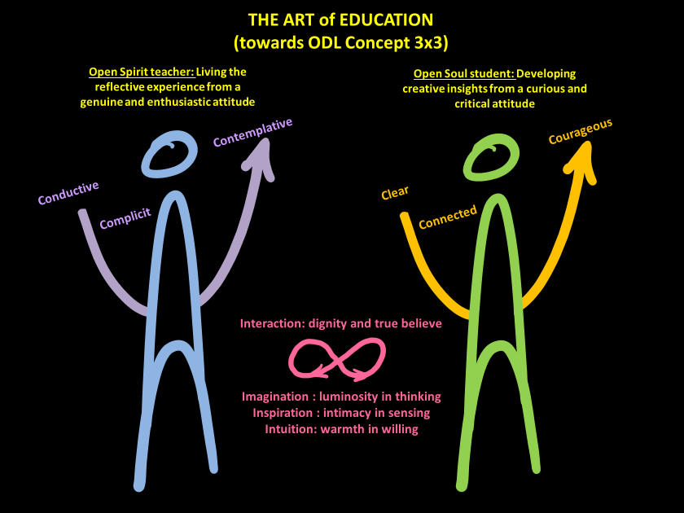
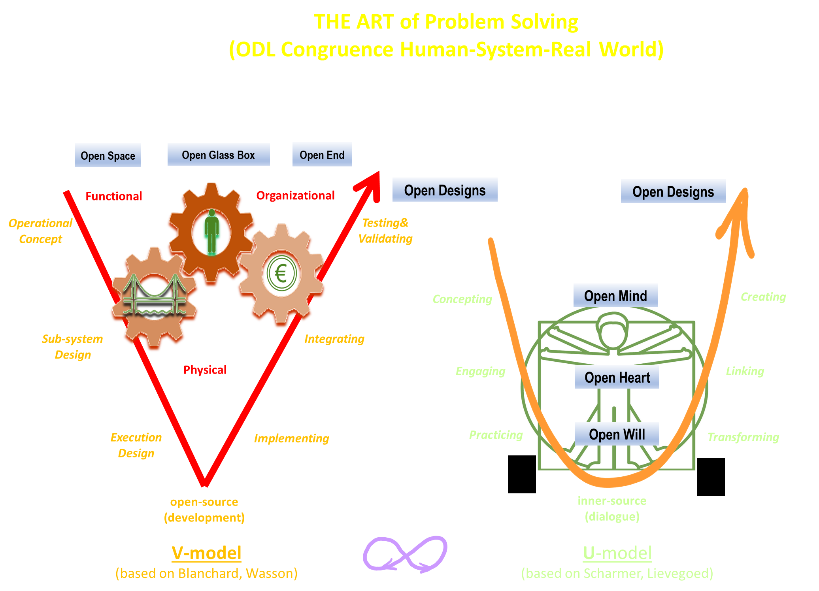
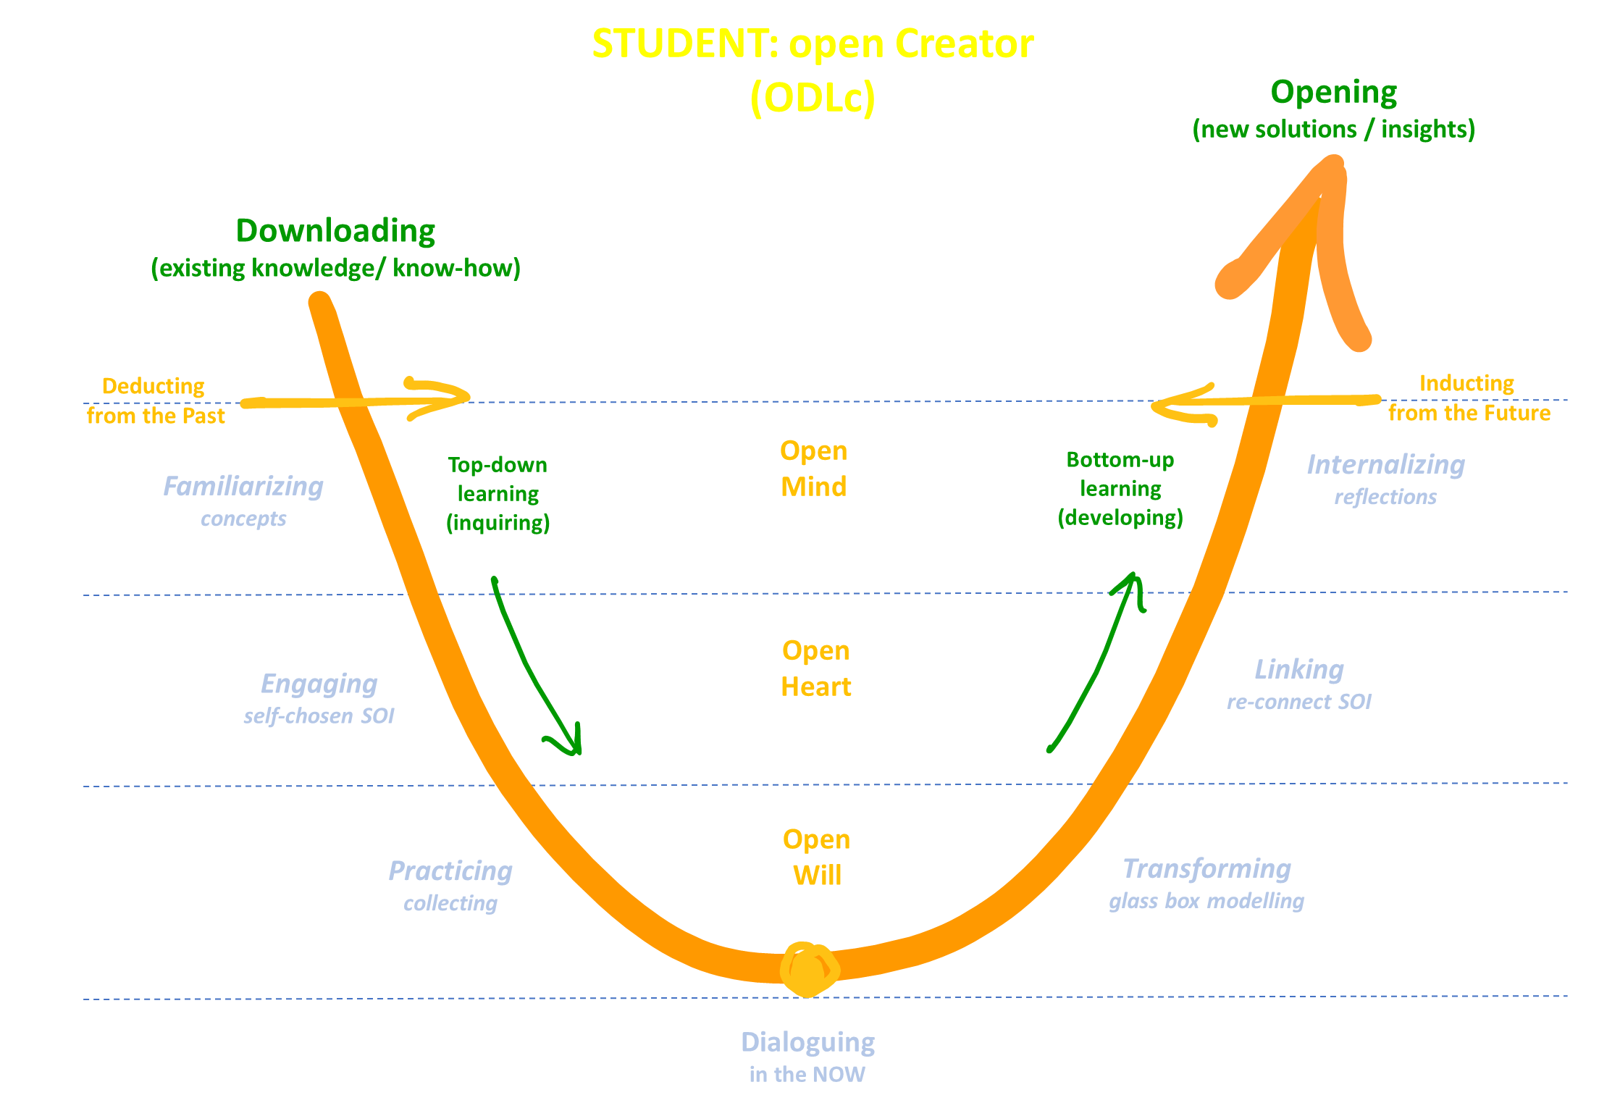
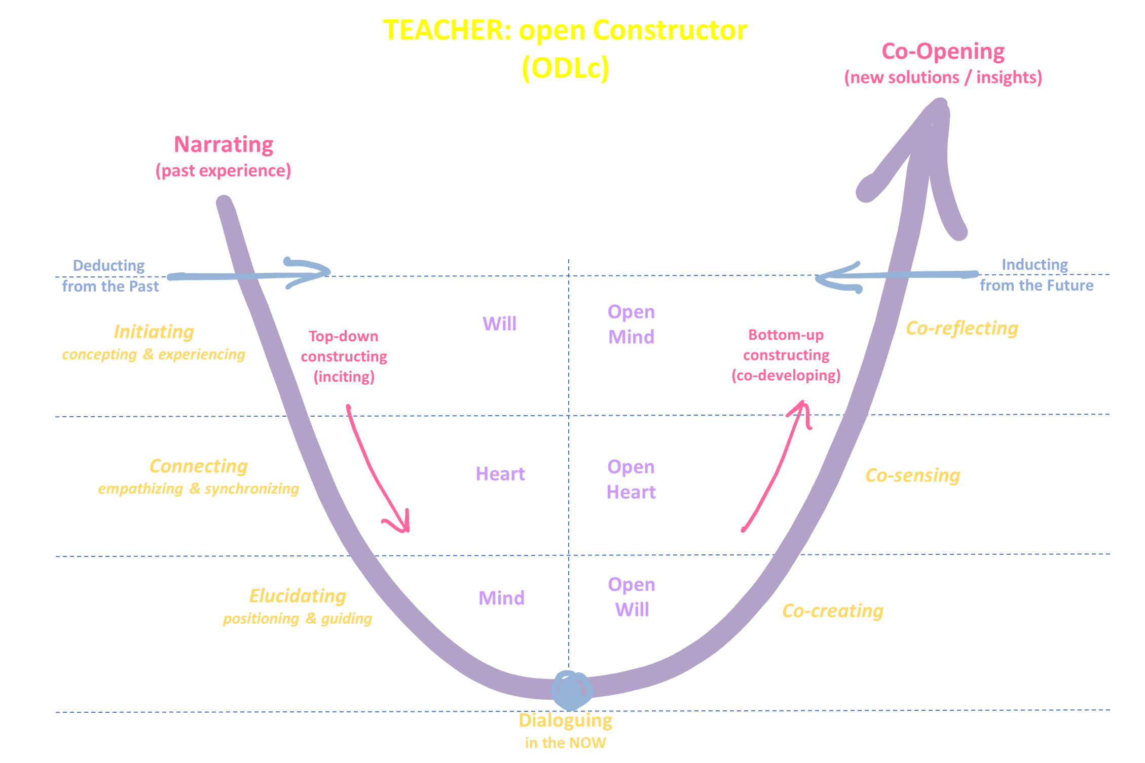

Slide 2
Open Design Learning concept
Topics:
Critical thinking – Querdenken - Common sense
Instructivistic vs. constructivistic paradigm
The art of problem solving
U,V,W and X/Y/Z
Experiential learning (‘erfahrungslehre’)
SoI – self-chosen to connect
Living dialogue
Concept – topics - weekly cycle / master class / ODL response
ODL response – transformation of concepts & topics
Course evaluation - commendation
Reference material

Slide 3
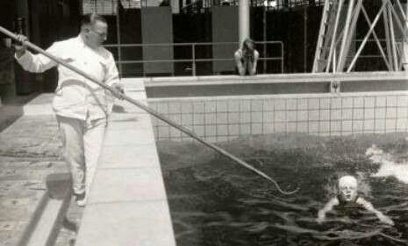
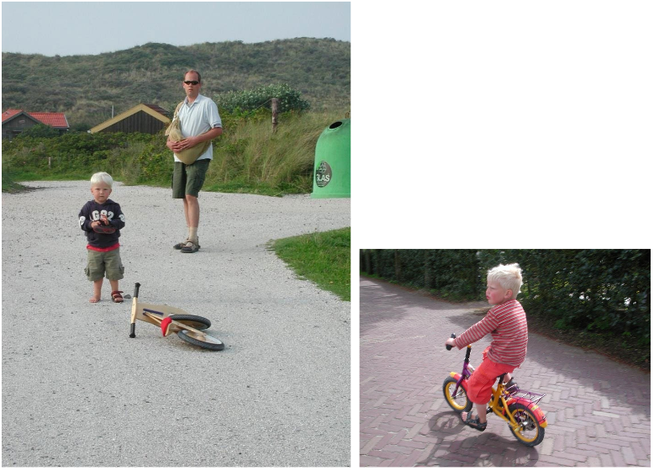
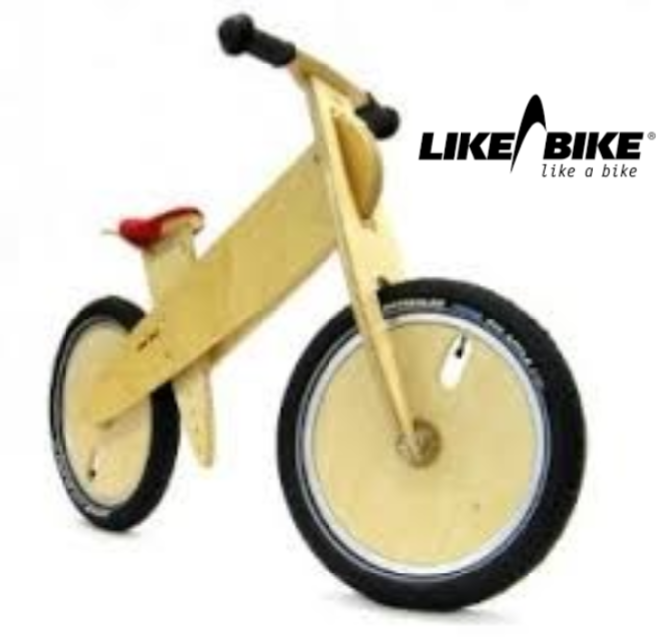
Like a bike
# Learning by experience
Don’t be afraid of the dark: we are there
www.open-design.school

Slide 4
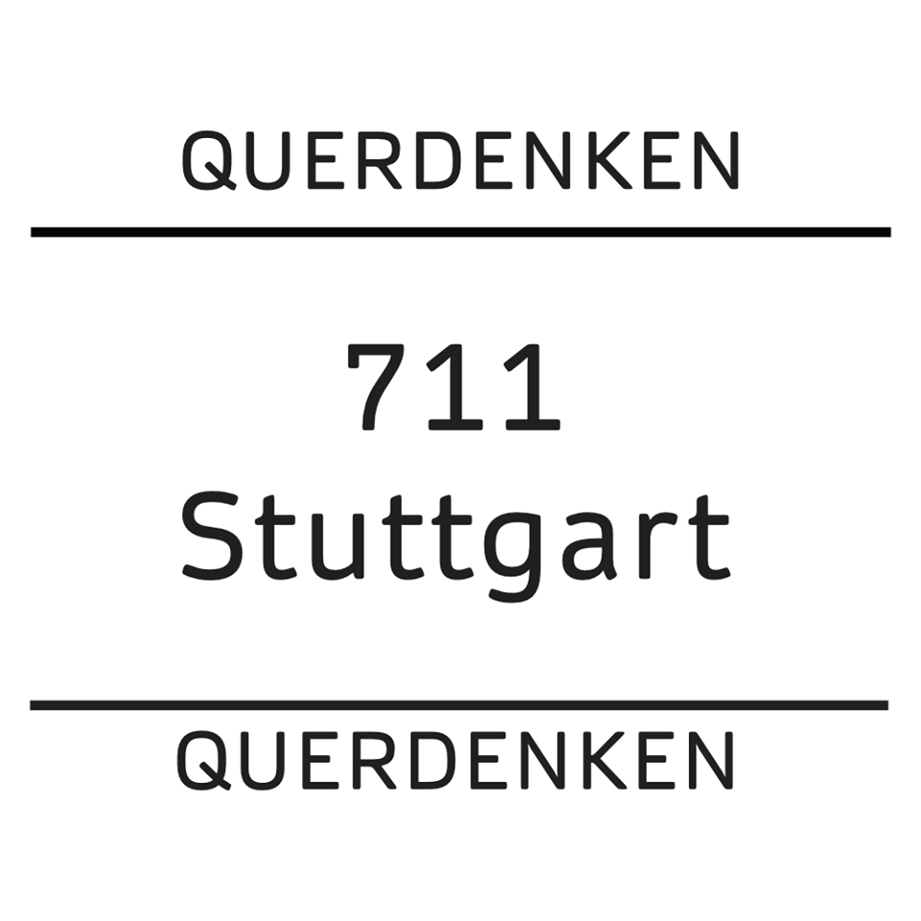
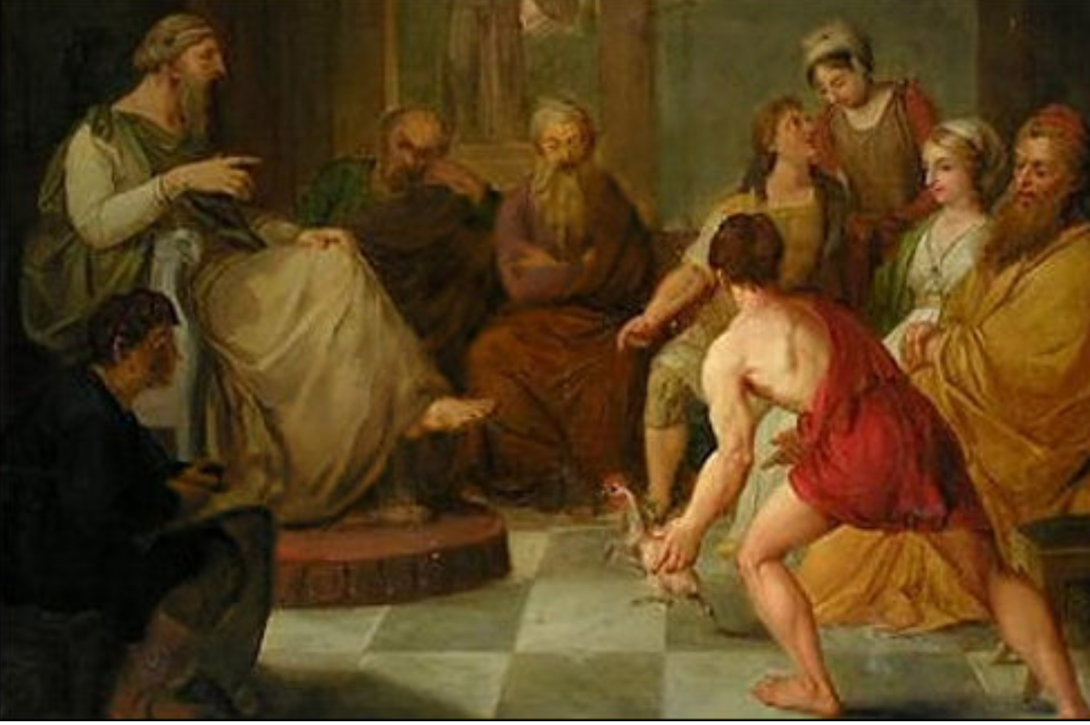
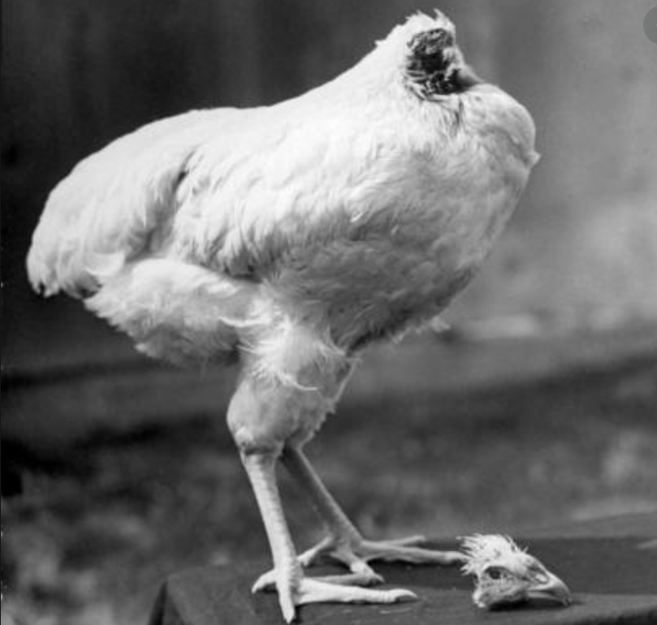
Critical thinking / Dialogue questions / Conscience
Plato and Diogenes: the plucked chicken (not becoming a chicken without head?)
# Science can also be just an opinion: be critical, con-scientific/ conscious

Slide 5
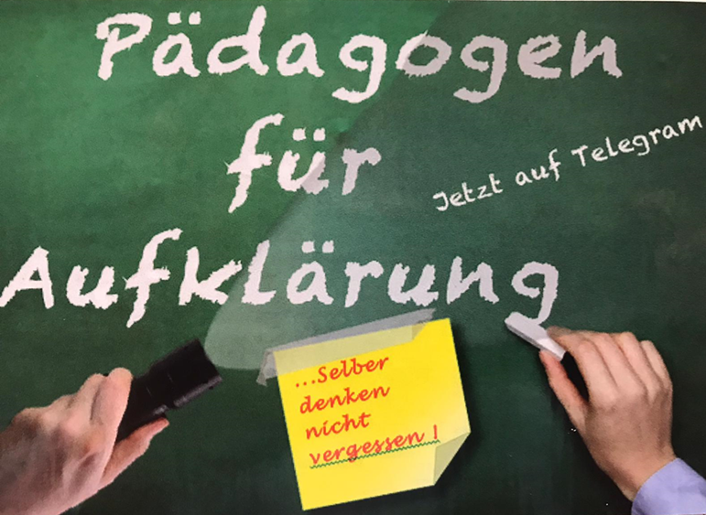
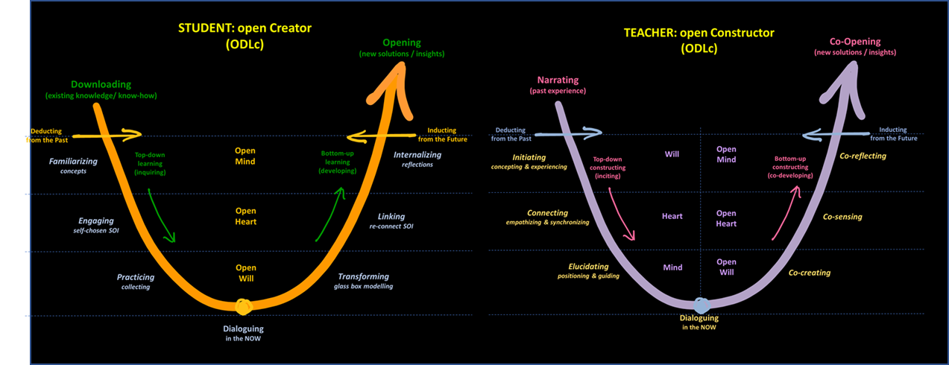
Instructivistic/ constructivistic → critical thinking problem solving
# Learning by Con-struction/ Unlearning by In-struction

Slide 6
Constructivism and Your feedback
# “throwing in the deep… we are there to construct with you” ☺ ?! “

Slide 7
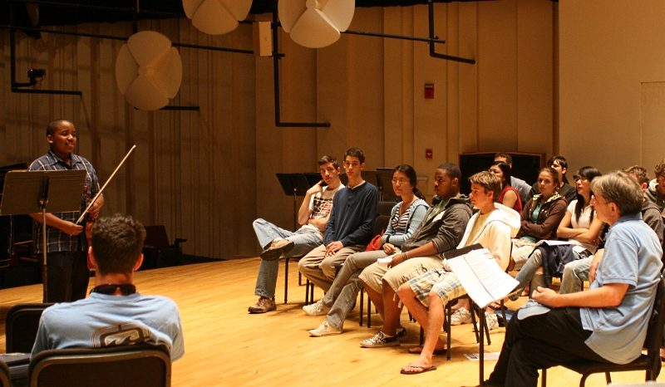
Con-ductor and Co-reflector / MasterClass
# The Masterclass

Slide 8
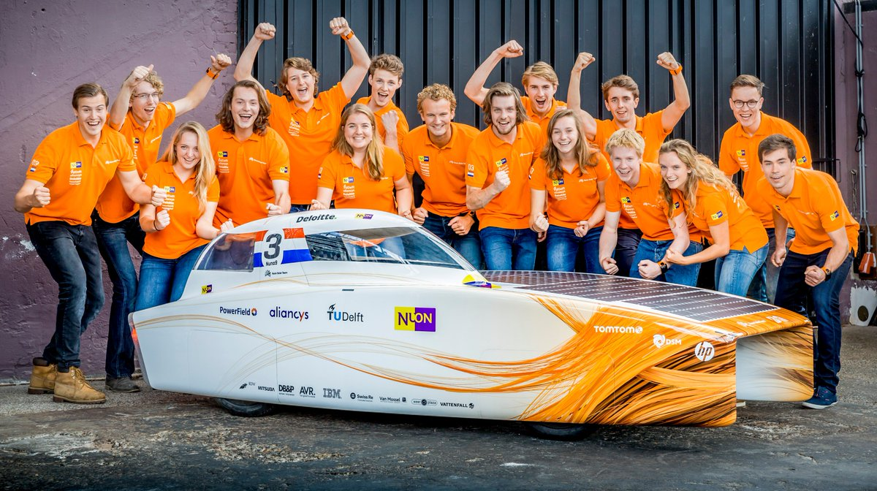
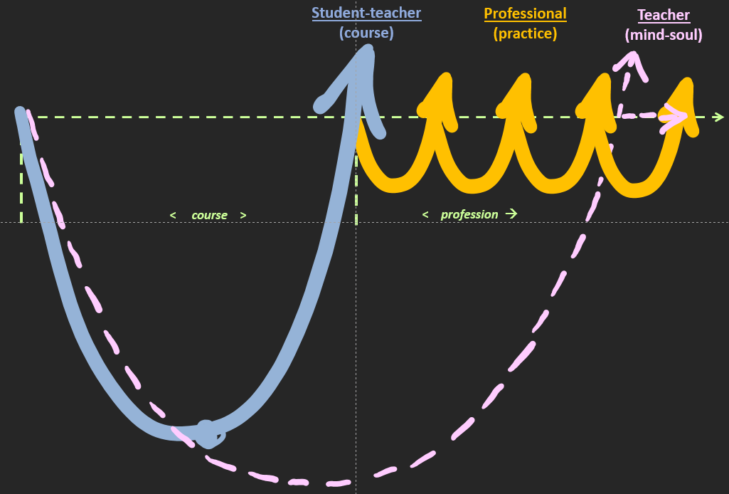
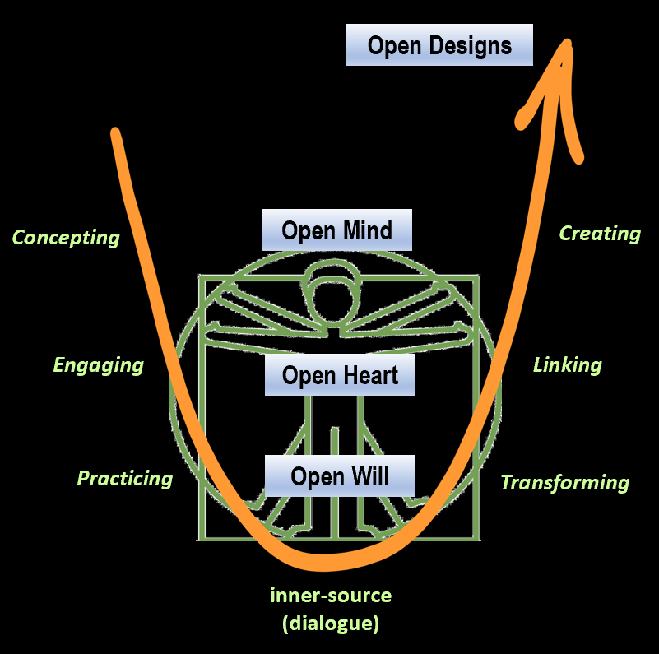
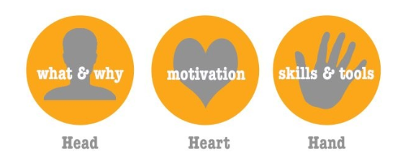
Experiential learning: your lifelong lasting ‘human memory’: persistent
# Gaining a valuable experience: dream team vs. test-based and persistent learning & development

Slide 9
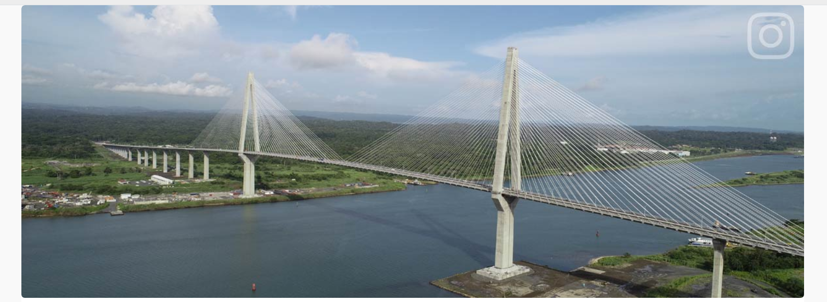
System of YOUR Interest (self-chosen SPoI, or PoI, or CPoI): “how are you connected”
# Maximizing your engagement : a self-chosen learning and development vehicle
Not case-based learning
Not problem-based learning (PBL)
But engagement- and development-based learning (non-conditionalized/self-stimulus)

Slide 10
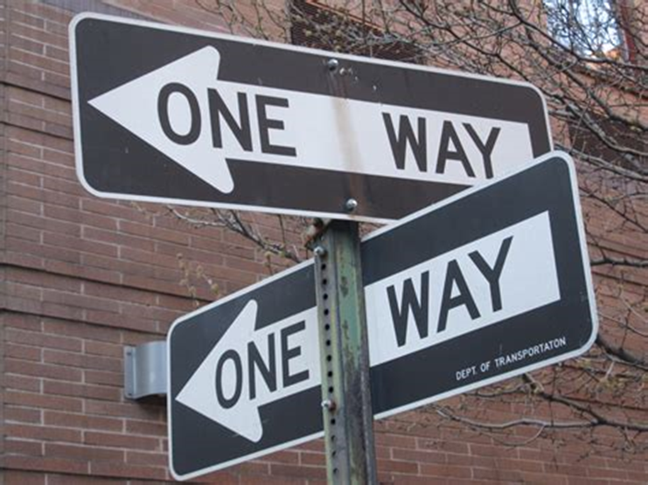
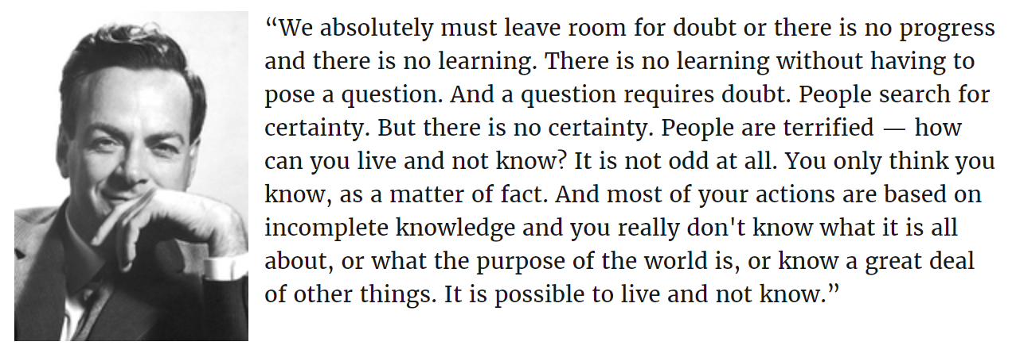
Living dialogue and Dialogue Questions: interaction and emergence
# The person only becomes Self through You : I and Thou!
# There is intelligence in doubts and questions, not in certainties

Slide 11
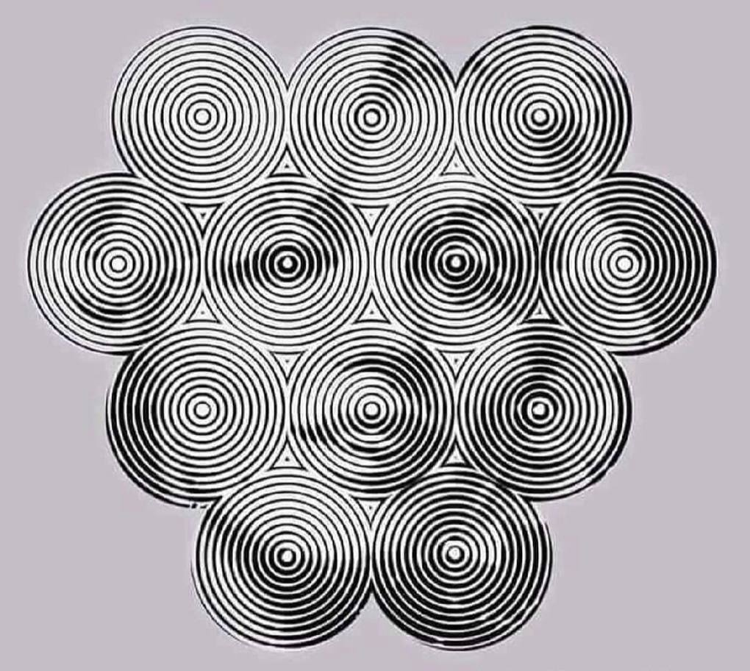
Systems Thinking &
Emergence

Slide 12
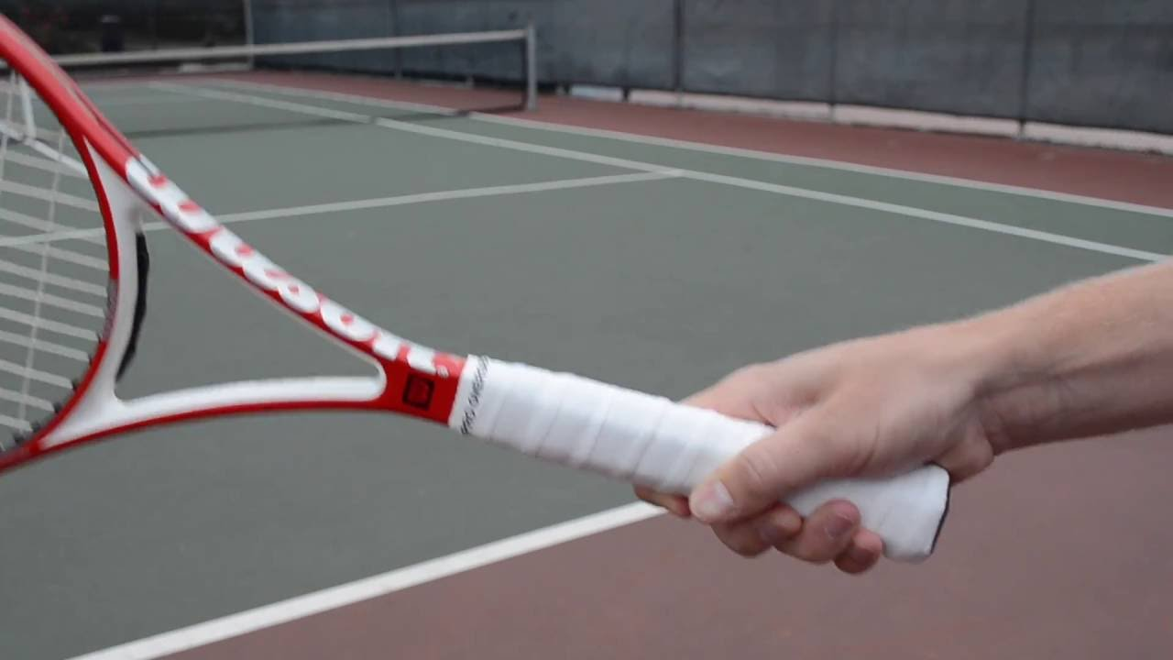
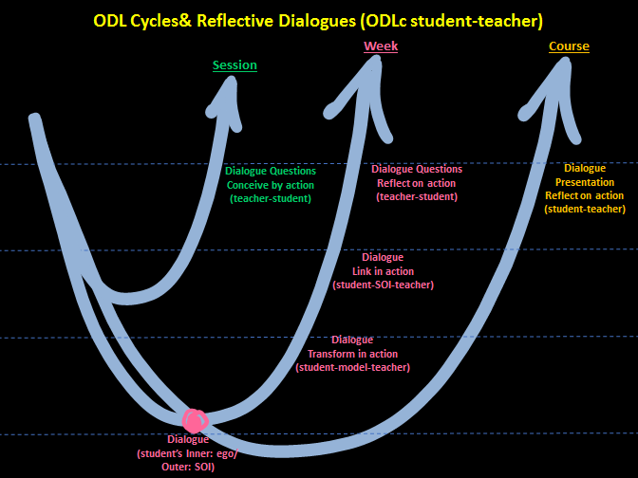
Reflect and co-reflect / cyclical
# Cyclical reflection

Slide 13
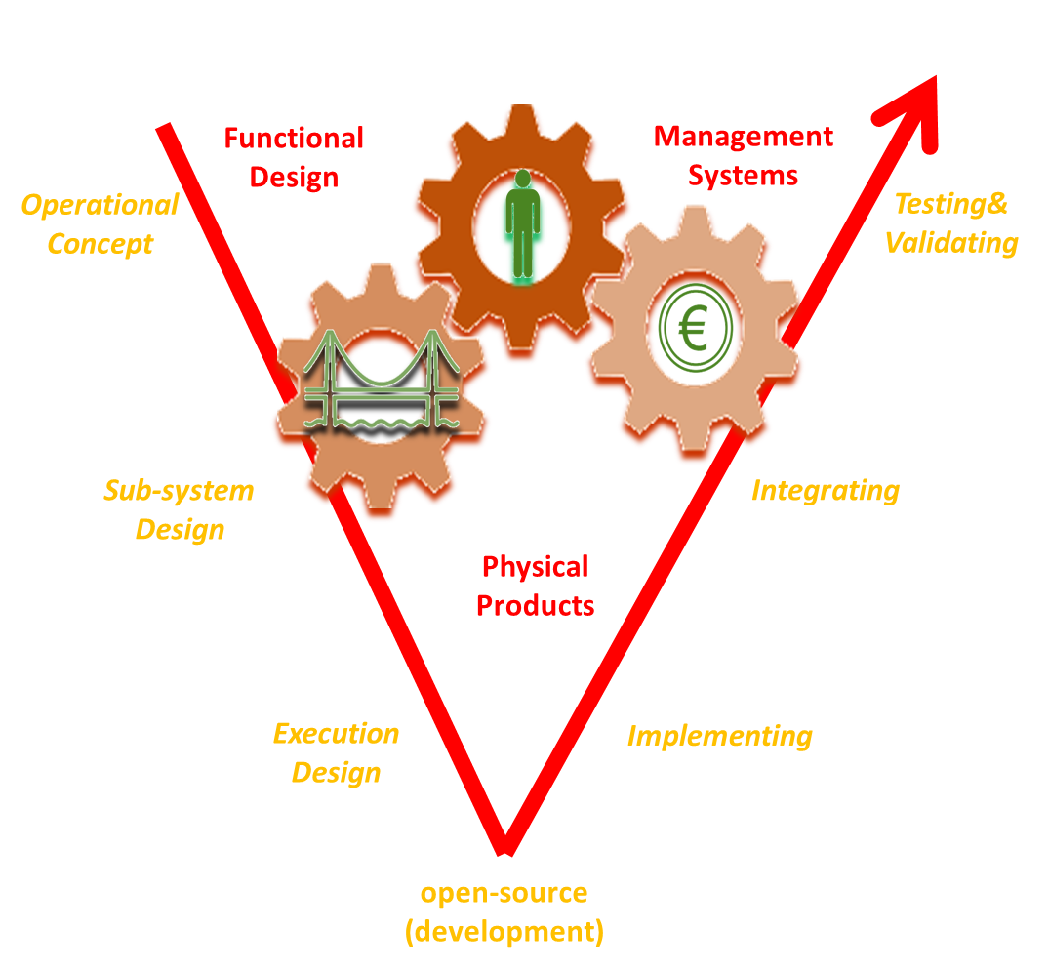
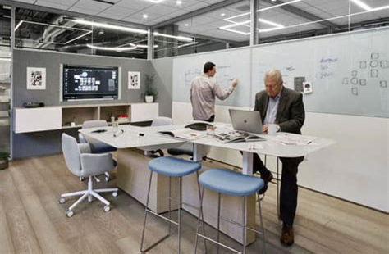
Art of creative problem solving, design for engineering products and management processes, V-model (U,V,W, X/Y/Z the letters of the ODL alphabet)
# R&D
t
t
scientist
design
Design of engineering products
researching
developing
Understand: new knowledge
Improve: new designs
Development of management systems/processes

Slide 14
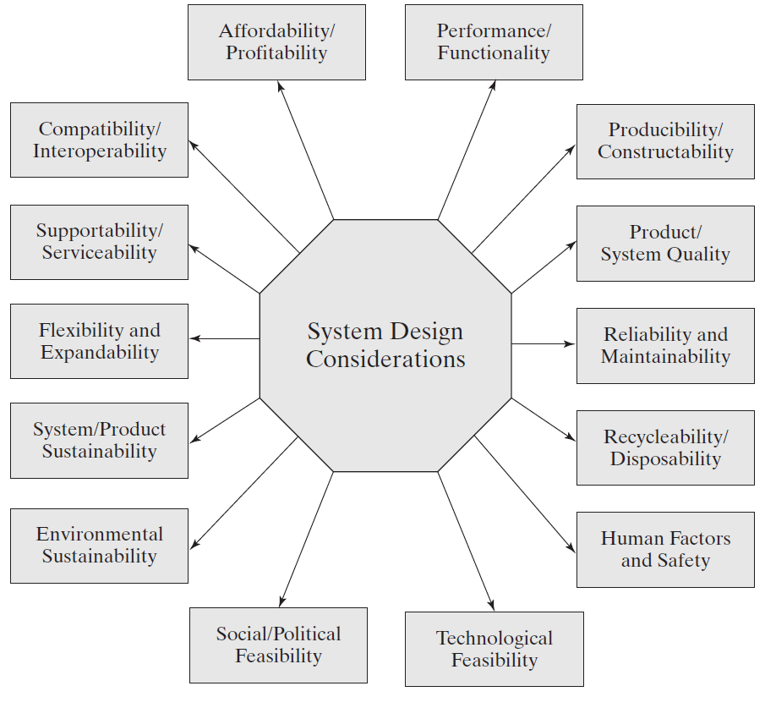
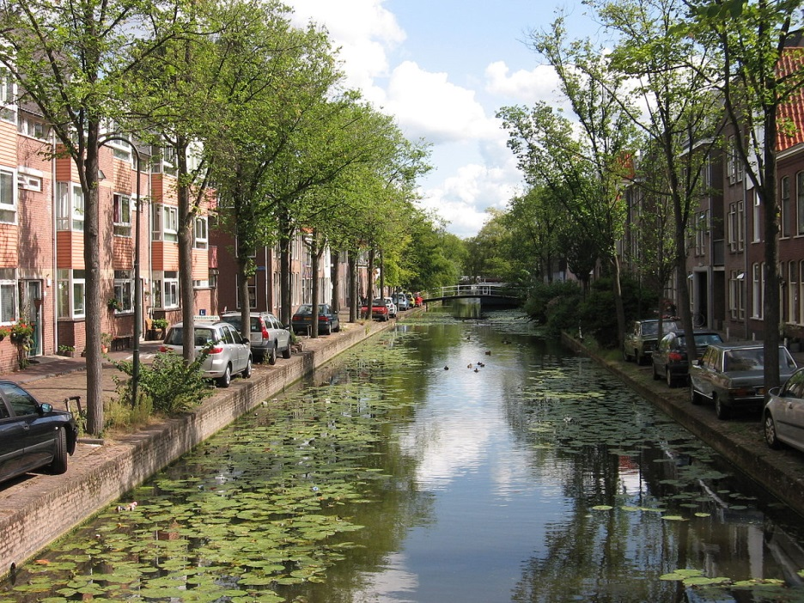
U,V,W, X/Y/Z the letters of the ODL alphabet
# systems thinking: design for Y,
# don’t be afraid of the dark: dear to try (X)
“Zeta” professional
ζ
Management
γ
Systems Design
for Y
Engineering
β

Slide 15
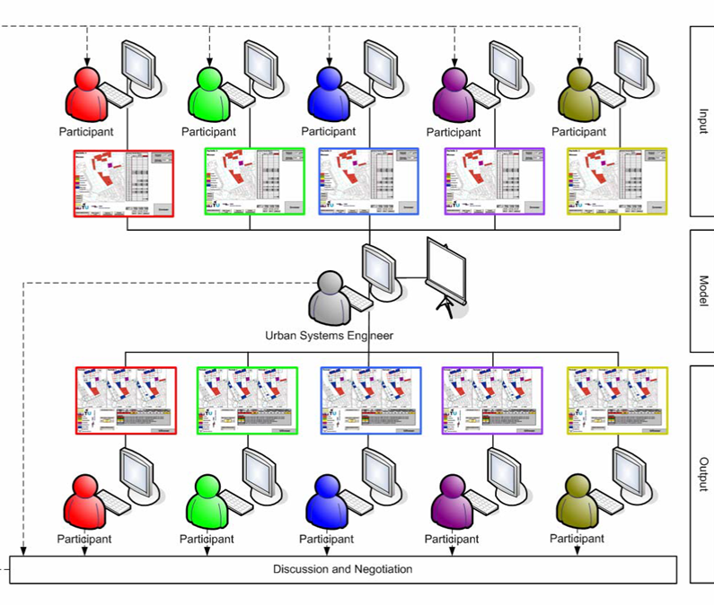
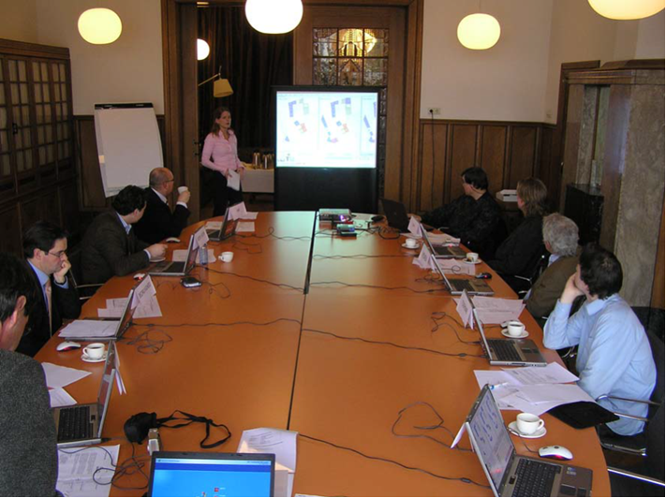
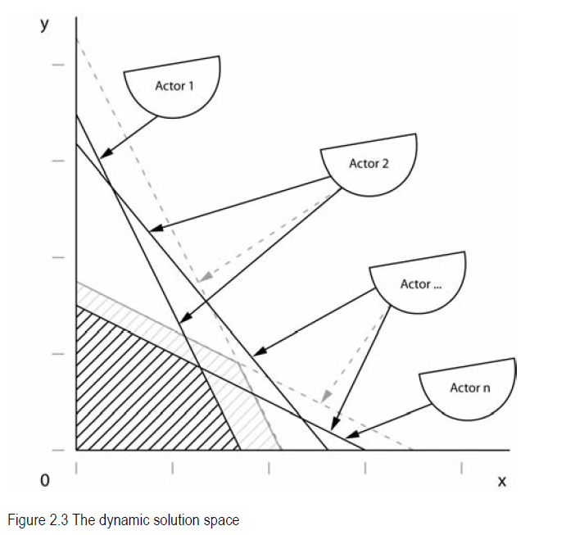
U,V,W, X/Y/Z the letters of the ODL alphabet : problem solving by mathematical modelling and simulation
# max/min Z = f (X,Y) <-> max U/V= f(X,Y) (the XYZ problem or Utility/Value)
Best fit for Common Purpose

Slide 16
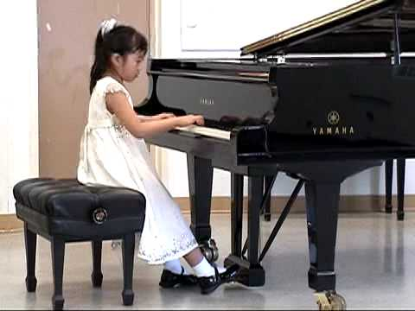
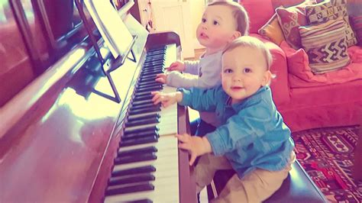
Multiple Integrative learning, U-model, Zeta-professional:
Knowing
(‘kennen’)
V
V
W
Inspiring
(‘kunnen’) Practicing
Integrate the thinking with the will via engagement
Imagination/Mind – Inspiration/Heart - Intuition/Will
“Zeta” professional
ζ
Management
Open Space & Design for Y
γ
Engineering
β

Slide 17
U/V/W/X/Y/Z letters of the ODLc alphabet
X
Don’t be afraid of the dark
X-factor
X-periental
Xyz problem solving
Open Ended
Design Variables
U
U-model: human
Inner ego development
Utility
C
Conscious
Creative
Critical
Commendation
Crystalline
Cogent
Construct
Concern
Convey
Courage
Care
Curiosity
Compile
Communicate
Combine
Compare
Compassion
….
Y
Open Space
Design for Y
xYz problem solving
Constraints
V
V-model: system
Outer eco development
Value
Z
Multiple Integrative
Interactive Dialogue
Max Z (xyZ solving)
Open Glassbox
W
Double loop V+V=W
Double Diamonds & Hearts

Slide 18
ODL response / Weekly cycle/ Transformation / clear & logical reasoning
# Transforming course concepts using your ‘System’ of Interest (SoI)
Emergence
Dialogue
Freedom

Slide 19
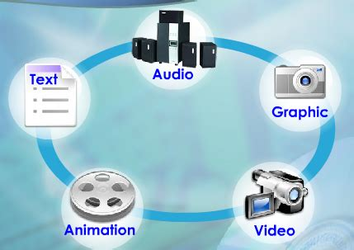
ODL response: your own way of transforming the concepts in an open format!
# no test/exam/pre-described format → self-created ODL response!!!
No copy paste of reference material, no master/slave instruction

Slide 20
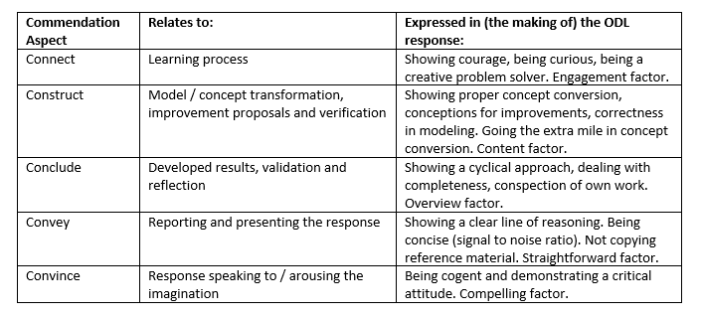
ODL response: commendation
# no rubric → commendation principle : you all start with a 10 and end with a final grade ….

Slide 21
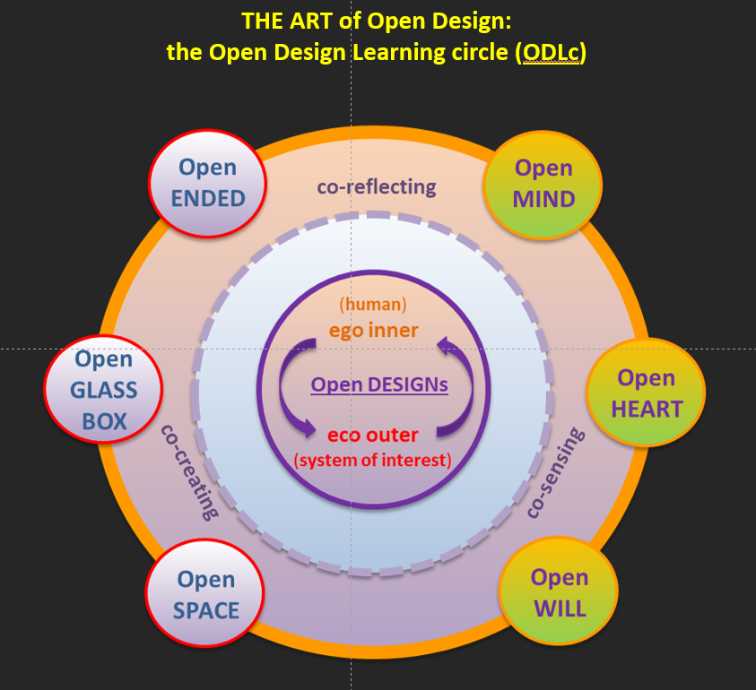
ODL Concept : a modern art of education

